Slide 1
REST API with Express Js
MongoDB
Rizal Maulana/3122600004/2 D4 IT A

Slide 2

Hello! I’m...
Here is where you introduce yourself.
You can add your name, title and a little background. Right click the image and replace it with your own.

Slide 3
STEP-STEP
Install Express, Mongoose, Nodemon, dan Cors
Testing Postman
Build Rest API Express
01
02
We will talk about this second.
03
Then, we will talk about this.

Slide 4
Installing
01
Install mongoose, nodemon, cors,

Slide 5
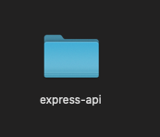
Buat folder express-api
Install init npm
npm init -y

Slide 6
Install express mongoose cors
Install nodemon
npm express mongoose cors
npm install -save-dev nodemon

Slide 7
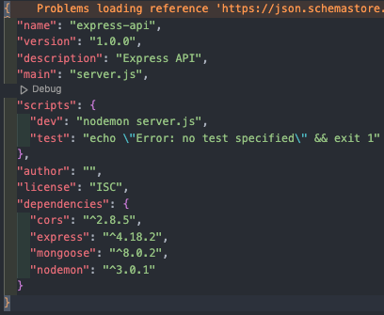
Hasil install

Slide 8
Build Rest API
02
Build Rest API using express js

Slide 9
Buat file bernama “server.js” pada folder express-api lalu masukan kode berikut
const express = require("express");
const cors = require("cors");
const db = require("./app/models");
const app = express();
const corsOptions = {
origin: "*",
};
//register cors middleware
app.use(cors(corsOptions));
app.use(express.json());
//konek ke database
const mongooseConfig = {
useNewUrlParser: true,
useUnifiedTopology: true,
};
db.corsOptions;
db.mongoose
.connect(db.url, mongooseConfig)
.then(() => {
console.log("database connected");
})
.catch((err) => {
console.log("gagal konek ke database", err);
process.exit();
});
//
require("./app/routes/mahasiswa.route")(app);
const PORT = process.env.PORT || 8000;
app.listen(PORT, () => {
console.log(`Server is running on port ${PORT}`);
});

Slide 10
Buat folder bernama “app” pada folder express-api lalu buat folder route dan buat file “mahasiswa.routes.js”
module.exports = (app) => {
const mahasiswa = require("../controllers/mahasiswa.controller.js");
const router = require("express").Router();
router.post("/", mahasiswa.create);
router.get("/", mahasiswa.findAll);
router.get("/:id", mahasiswa.show);
router.put("/:id", mahasiswa.update);
router.delete("/:id", mahasiswa.delete);
app.use("/mahasiswa", router);
};

Slide 11
Buat folder bernama “config” pada folder app lalu buat file “database.js”
Buat folder bernama “models” pada folder app lalu buat file “mahasiswa.models.js”
module.exports = {
url: "mongodb://localhost:27017/express_api",
};
const { default: mongoose } = require("mongoose");
module.exports = (mongoose) => {
const schema = mongoose.Schema(
{
nama_mahasiswa: String,
nrp: String,
jurusan: String,
},
{ timestamps: true }
);
schema.method("toJSON", function () {
const { __v, _id, ...object } = this.toObject();
object.id = _id;
return object;
});
return mongoose.model("mahasiswa", schema);
};

Slide 12
Buat file “index.js” pada folder models
const dbConfig = require("../config/database");
const mongoose = require("mongoose");
module.exports = {
mongoose,
url: dbConfig.url,
mahasiswa: require("./mahasiswa.model.js")(mongoose),
};

Slide 13
Buat file “mahasiswa.controller.js” pada folder controllers
const db = require("../models");
const mahasiswa = db.mahasiswa;
exports.create = async (req, res) => {
try {
const data = await mahasiswa.create(req.body);
return res.send(data);
} catch (err) {
return res.status(500).send({
message: err.message || "Error creating mahasiswa",
});
}
};
exports.findAll = async (req, res) => {
try {
const data = await mahasiswa.find().lean();
res.send(data);
} catch (err) {
res.status(500).send({
message: err.message || "Error occurred while retrieving mahasiswa.",
});
}
};

Slide 14
Buat file “mahasiswa.controller.js” pada folder controllers
exports.show = async (req, res) => {
const id = req.params.id;
try {
const data = await mahasiswa.findById(id);
res.send(data);
} catch (err) {
res
.status(500)
.send({ message: err.message || "Error retrieving mahasiswa." });
}
};
exports.update = async (req, res) => {
const id = req.params.id;
try {
const data = await mahasiswa.findByIdAndUpdate(id, req.body, {
useFindAndModify: false,
});
const message = data
? "mahasiswa was updated successfully."
: `Cannot update mahasiswa with id=${id}. Maybe mahasiswa was not found!`;
res.send({ message });
} catch (err) {
res.status(500).send({
message: "Error updating mahasiswa with id=" + id,
});
}
};

Slide 15
Buat file “mahasiswa.controller.js” pada folder controllers
exports.delete = async (req, res) => {
const id = req.params.id;
try {
const data = await mahasiswa.findByIdAndRemove(id);
const message = data
? "mahasiswa was deleted successfully!"
: `Cannot delete mahasiswa with id=${id}. Maybe mahasiswa was not found!`;
res.send({ message });
} catch (err) {
res.status(500).send({
message: "Could not delete mahasiswa with id=" + id,
});
}
};

Slide 16
Testing API
03
Testing rest api express using postman

Slide 17
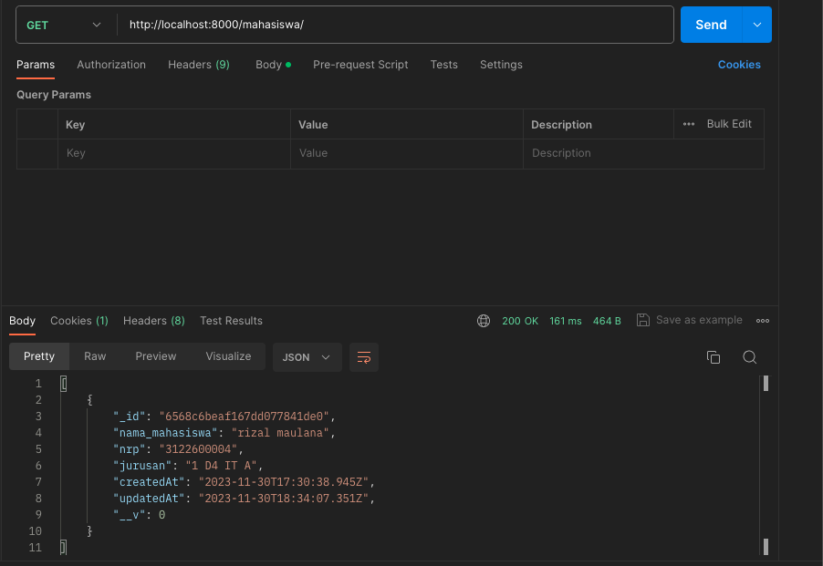
Testing get all data

Slide 18
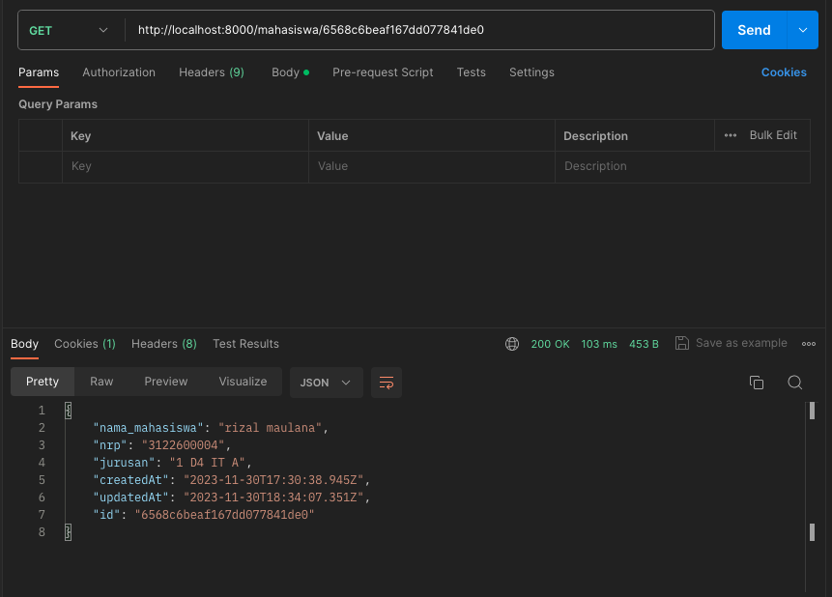
Testing get data specific by id

Slide 19
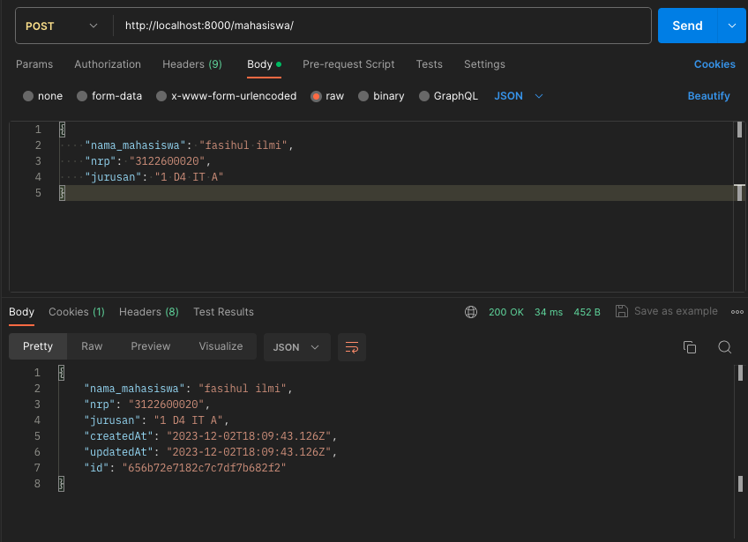
Testing create data

Slide 20
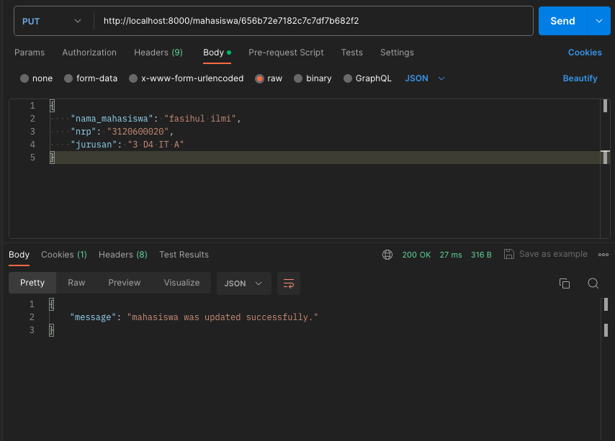
Testing update data

Slide 21
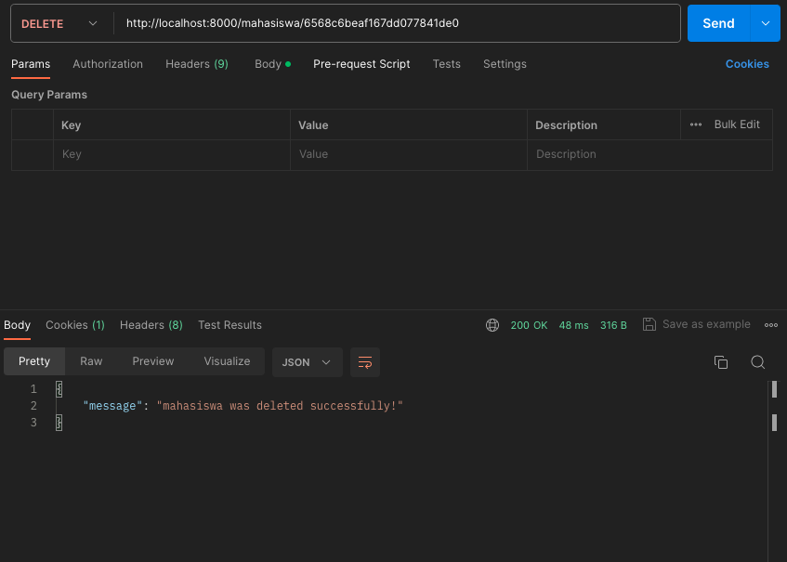
Testing delete data

Slide 22
Thank you!

